Slide 1
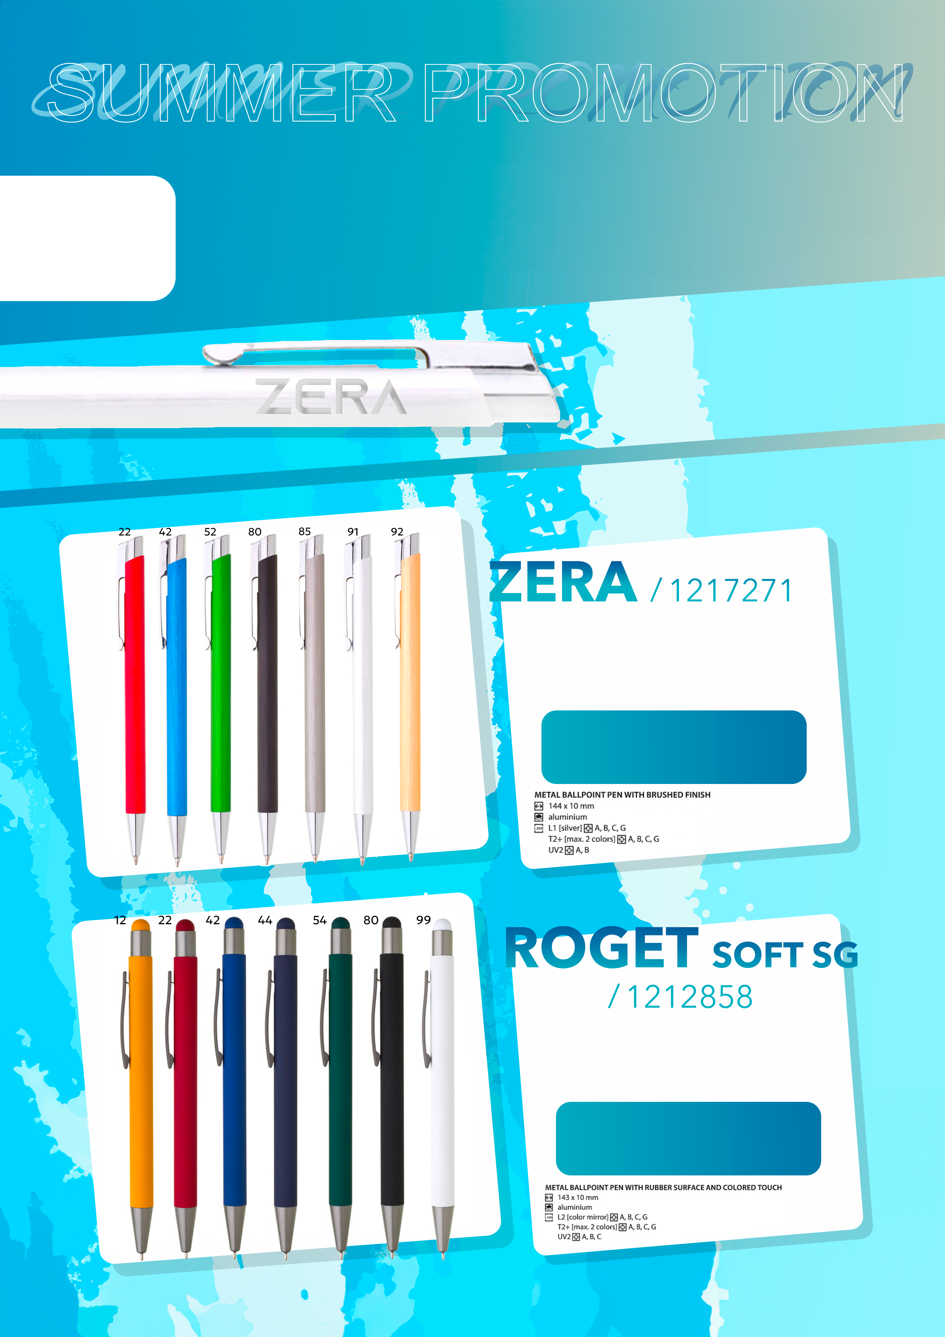
-60
%
YOUR
LOGO
off catalog prices
FOR SELECTED PENS
FREE LASER
FROM 250 PCS
LASER + FREE START-UP
valid for 1 logo / pen
0,83 EUR
0,33 EUR
FROM 250 PCS
LASER + FREE START-UP
valid for 1 logo / pen
0,83 EUR
0,33 EUR
The promotion is for items in this brochure ordered between June 3 and August 15, 2024, or until sold out, whichever comes first. Prices do not include VAT.

Slide 2
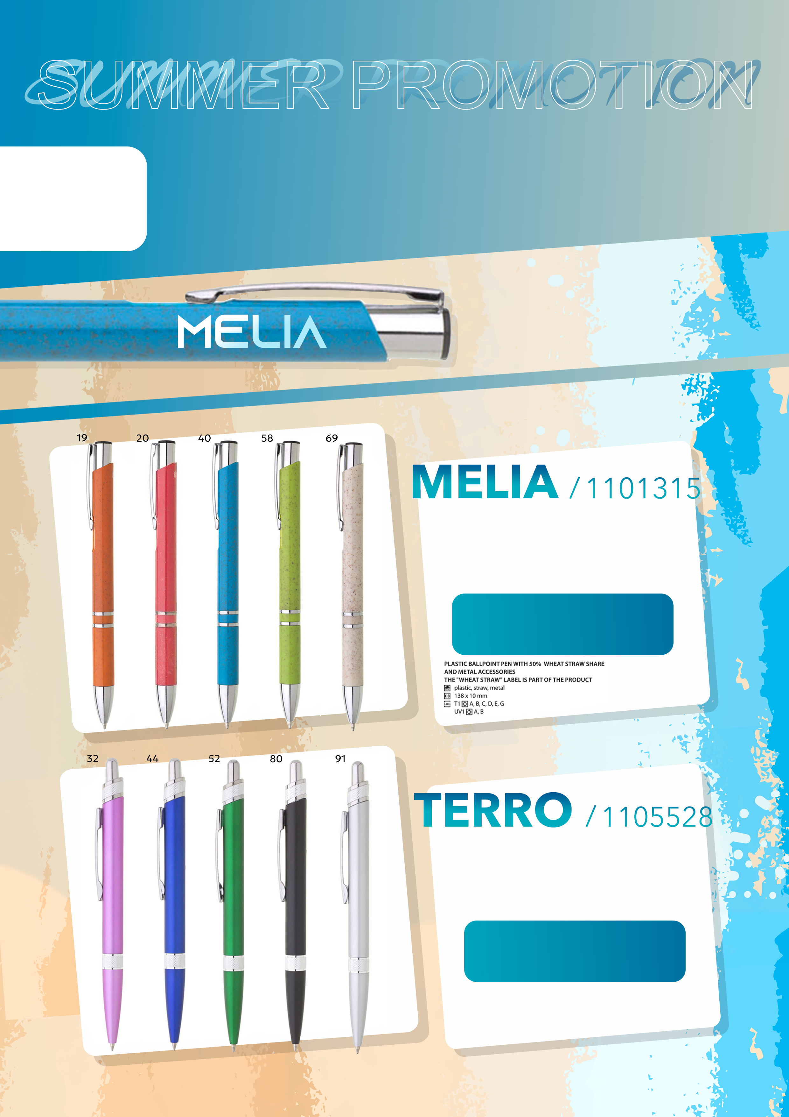
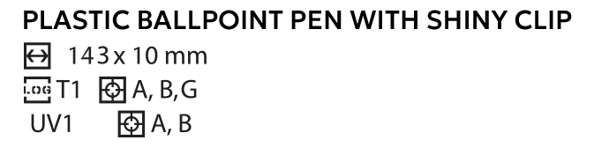
-60
%
YOUR
LOGO
off catalog prices
FOR SELECTED PENS
FREE
UV PRINT
UV PRINTING + FREE START-UP COST
FREE FROM 500 PCS
from 250 – 499 pcs printing for 0,04 EUR + start-up
valid for 1 logo / pen
0,34 EUR
0,14 EUR
UV PRINTING + FREE START-UP COST
FREE FROM 500 PCS
from 250 – 499 pcs printing for 0,04 EUR + start-up
valid for 1 logo / pen
0,40 EUR
0,16 EUR
The promotion is for items in this brochure ordered between June 3 and August 15, 2024, or until sold out, whichever comes first. Prices do not include VAT.

